Slide 1
Discuss challenges in India's agriculture and their impact on food security, rural livelihoods, and economic development.
Indian Economy P.Pt. By -635

Slide 2
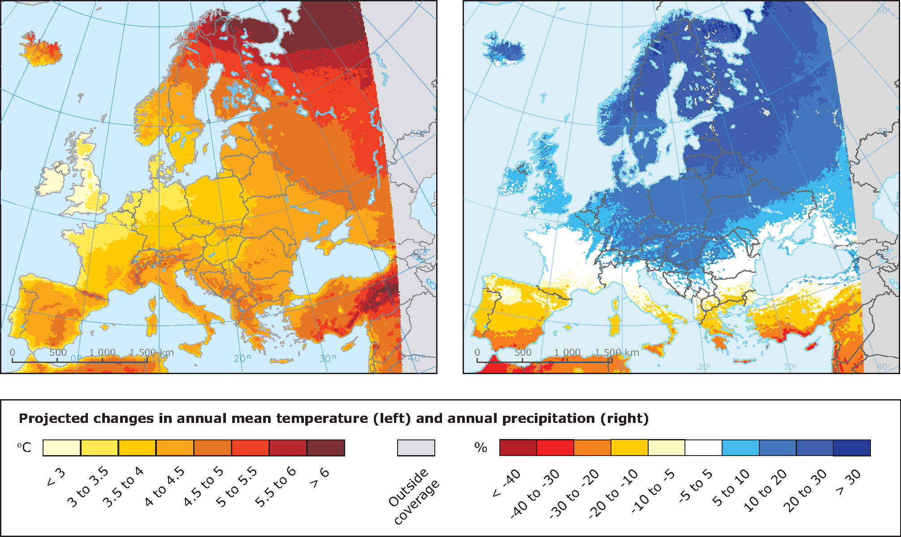
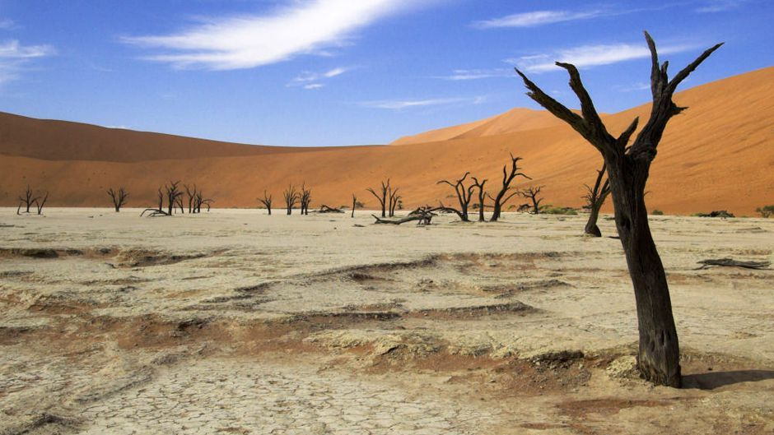
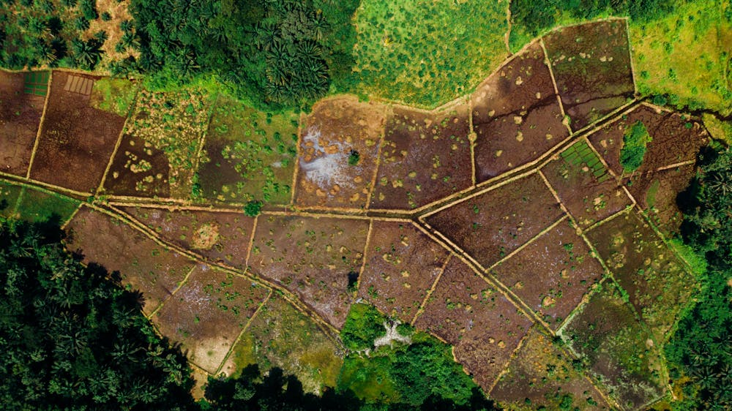
1. Climate Change and Environmental Stress
Erratic Weather Patterns: Unpredictable monsoon seasons, increased frequency of droughts, floods, and cyclones disrupt crop cycles.
Soil Degradation: Overuse of chemical fertilizers and pesticides, monocropping, and improper irrigation practices lead to soil health deterioration.
Water Scarcity: Groundwater depletion and inefficient water management reduce water availability for irrigation.
2. Fragmented Land Holdings
Small and Marginal Farms: The majority of farmers own small plots, limiting economies of scale and mechanization.
Land Fragmentation: Inheritance practices further divide land into smaller, less productive parcels.

Slide 3

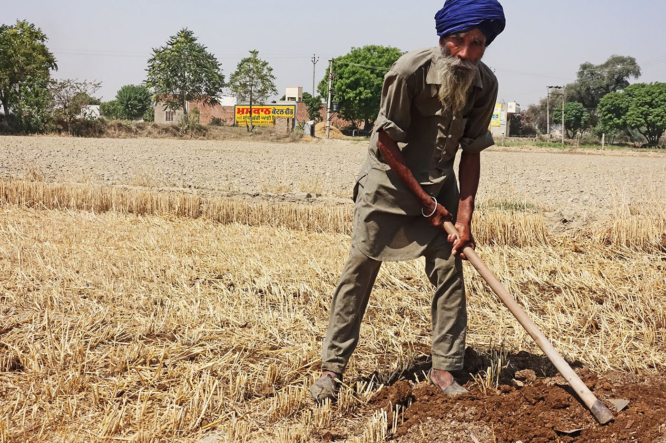
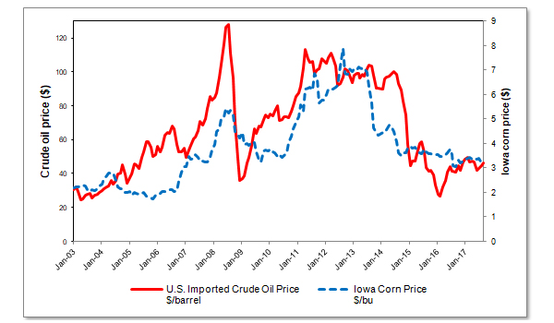

4. Financial Constraints
Limited Access to Credit: Small farmers often struggle to obtain affordable credit due to lack of collateral and high interest rates.
Indebtedness: Many farmers are trapped in cycles of debt, exacerbated by crop failures and low income.
5. Market Inefficiencies
Price Volatility: Fluctuations in market prices for crops can lead to financial instability for farmers.
Middlemen: Farmers often receive a small fraction of the final market price due to the presence of intermediaries in the supply chain.

Slide 4
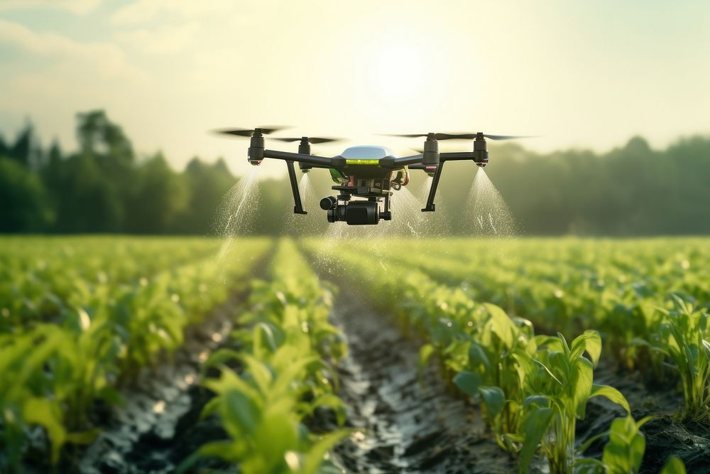
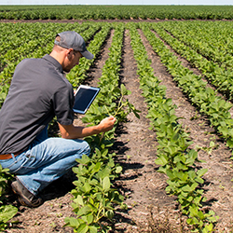

6. Technological Barriers
Low Adoption of Modern Techniques: Limited awareness and access to modern farming practices and technologies hinder productivity.
Research and Development: Inadequate investment in agricultural research and development affects innovation and improvement in farming methods.
7. Policy and Governance Issues
Subsidy Distortions: Inefficient subsidy systems often favor certain crops or inputs, leading to imbalances in agricultural practices.
Implementation Gaps: Poor implementation of agricultural policies and schemes reduces their effectiveness.

Slide 5
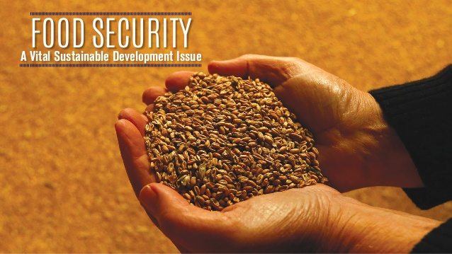
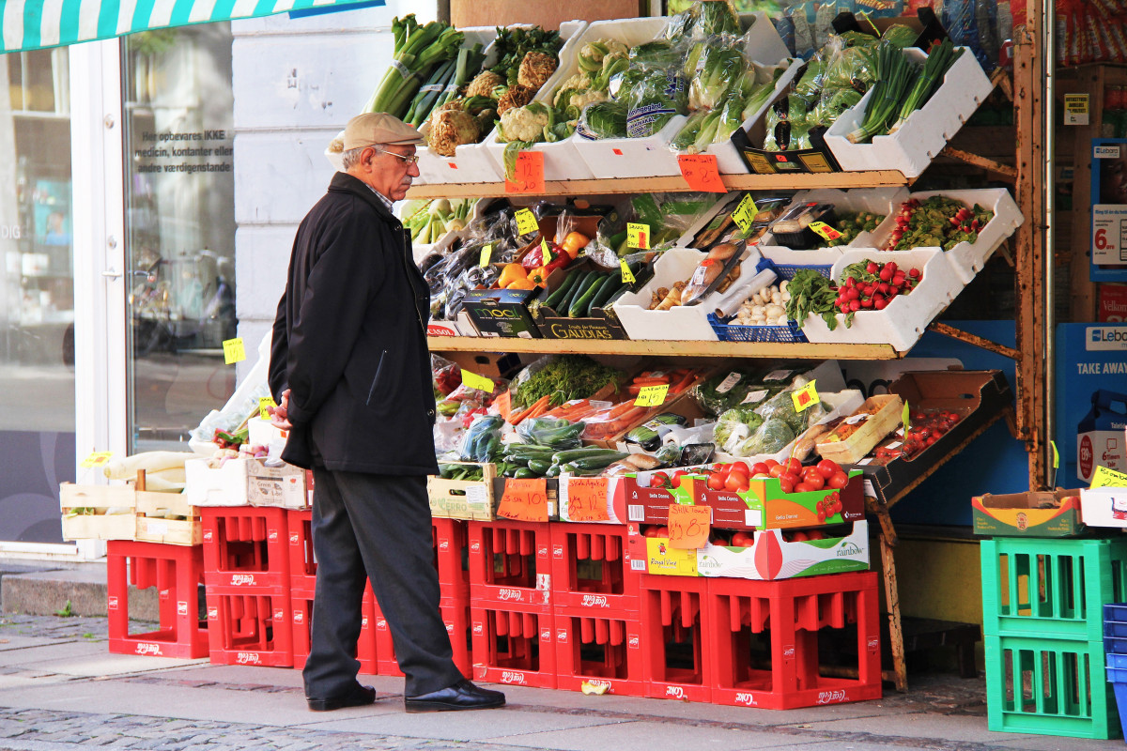
The challenges in India's agriculture sector have profound impacts on food security, rural livelihoods, and economic development. Let's delve deeper into these impacts:
1. Food Security
Production Uncertainty
Reduced Yields: Erratic weather conditions and environmental stress can lead to significant reductions in crop yields. For instance, droughts and unseasonal rains can destroy crops, reducing overall food production.
Crop Failures: Extreme weather events can cause complete crop failures, leading to acute food shortages in affected regions.
Nutritional Quality
Staple Crop Dominance: Policies and subsidies often encourage the cultivation of staple crops like rice and wheat at the expense of more diverse and nutritionally rich crops. This can result in a lack of dietary diversity and nutritional deficiencies.
Decline in Traditional Crops: Traditional, nutrient-rich crops like millets and pulses are often neglected, further reducing dietary diversity and nutritional quality.

Slide 6
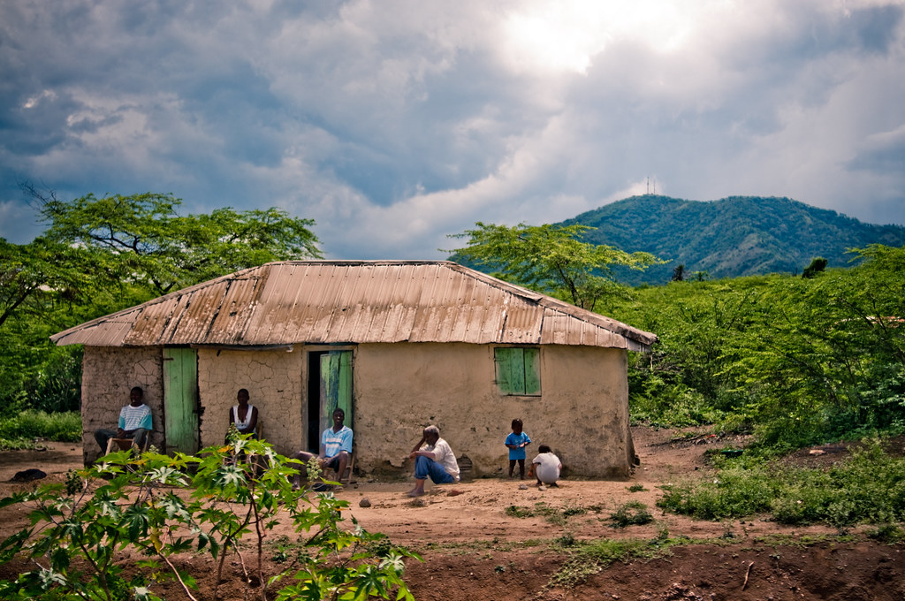
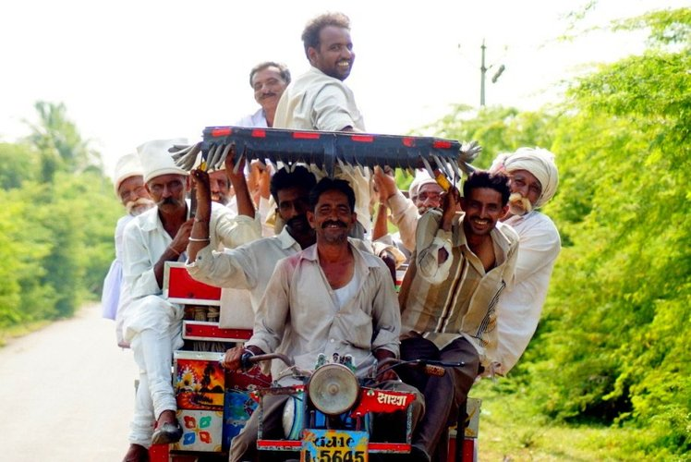
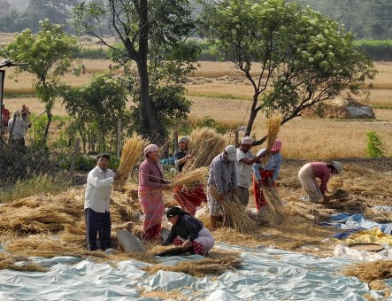
2. Rural Livelihoods
Income Instability:
Price Volatility: Market prices for agricultural products can fluctuate widely, often dropping below the cost of production, leading to financial losses for farmers.
High Input Costs: Rising costs of seeds, fertilizers, and pesticides add to the financial burden on farmers, reducing their profit margins.
Migration:
Rural-Urban Migration: Unstable and insufficient agricultural income pushes many rural residents to migrate to urban areas in search of better employment opportunities. This migration can lead to labor shortages in the agricultural sector and overcrowding in cities.
Indebtedness and Poverty:
Debt Traps: Farmers often take loans to cover input costs. When crops fail or prices drop, they struggle to repay these loans, leading to cycles of debt and poverty.
Farmer Suicides: Financial stress and indebtedness have led to a distressing number of farmer suicides, highlighting the severe impact on mental health and well-being.

Slide 7
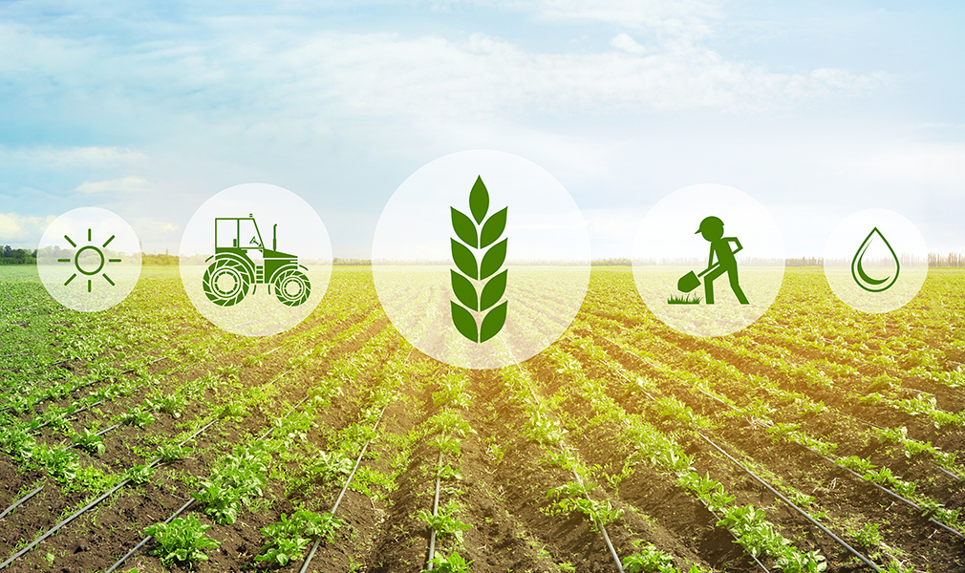


3. Economic Development
Agricultural GDP:
Economic Contribution: Agriculture is a significant contributor to India's GDP. Challenges in the sector can slow down overall economic growth and affect the entire economy.
Rural Economy: A struggling agricultural sector directly impacts the rural economy, leading to reduced spending power and economic stagnation in rural areas.
Employment:
Underemployment: Agriculture employs a large portion of the Indian workforce. However, due to low productivity and financial instability, many agricultural workers are underemployed, contributing to rural poverty.
Youth Unemployment: The lack of attractive opportunities in agriculture drives young people to urban areas, leading to an aging farming population and reduced agricultural innovation.
Regional Disparities:
Uneven Development: Agricultural challenges exacerbate regional disparities, with areas having better irrigation and infrastructure faring better than those without.
Rural-Urban Divide: The disparity between rural and urban areas can widen, leading to increased social and economic inequalities.
This Photo by Unknown Author is licensed under CC BY-SA

Slide 8
Thank You P.Pt. By- 635

